Slide 1
Web Scraping using R: Extracting and Analyzing Journal Article Data

Slide 2
Introduction
Objective
To learn & explore about web scrapping, data visualization in different forms saying barographs, pie charts, histograms & etc.
Web scraping is the art of extracting information from the HTML, CSS and Javascript lines of code.
Most commonly used package for web scrapping in R programming language is rvest.
Rvest provides functions to access a web page and specific elements using CSS selectors and XPath.
Topic: immunity and ageing

Slide 3
Steps involved
Setting up the environment
Scraping data from web
Cleaning & pre-processing
Data Analyzation & visualization

Slide 4
Setting up the Environment
For the scraping of data from web we use rvest package
httr package is used for making HTTP requests
Xml2 package is used to work with HTML and XML form of data

Slide 5
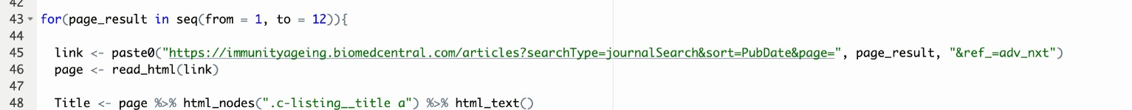
Scraping data from Web
Used Selector gadget web extension to read the class and element names.
Using few functions such as html_text, html_nodes, html_attributes, read_html and son on for reading the html file.
Used a for loop to read multiple pages from the link, as there were almost 12 pages where each page had almost 50 journal details.

Slide 6
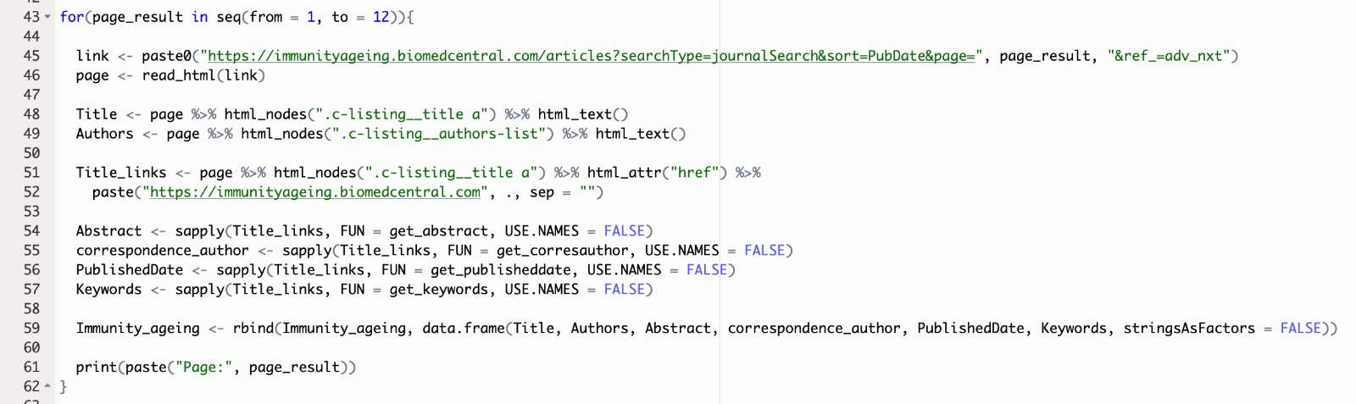

Slide 7
Cleaning and Pre-Processing
Data Cleaning is the process of correcting or removing corrupt, incorrect or unnecessary data from the data set before data analysis.
Most common cleaning steps include:
Handling missing data
Outlier Detection and treatment
Removing Duplicates
Data Validation

Slide 8
Cleaning and Pre-Processing
Data pre-processing involves transforming data into a basic form that makes it easy to work with.
Data Pre-Processing techniques:
Data Integration
Data Transformation
Feature selection
Encoding Categorical Variables
Handling Imbalanced Data

Slide 9
Data Analysis and Visualization
Data visualization is the technique used to deliver insights in data using visual cues such as graphs, charts, maps, and many others. This is useful as it helps in intuitive and easy understanding of the large quantities of data and thereby make better decisions regarding it .
We use a library ggplot2 , It is plotting package that provides helpful commands to create complex plots from data in a data frame.

Slide 10
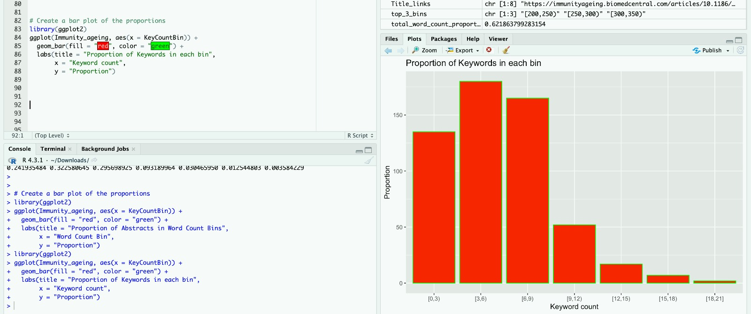
the code analyzes the distribution of keyword counts in a set of articles and presents the information in a bar plot, making it easier to understand the patterns in the dataset. The bins help group articles based on the number of keywords they contain.

Slide 11
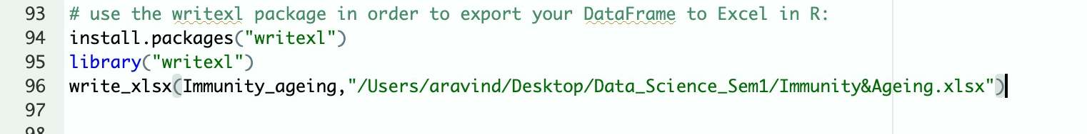
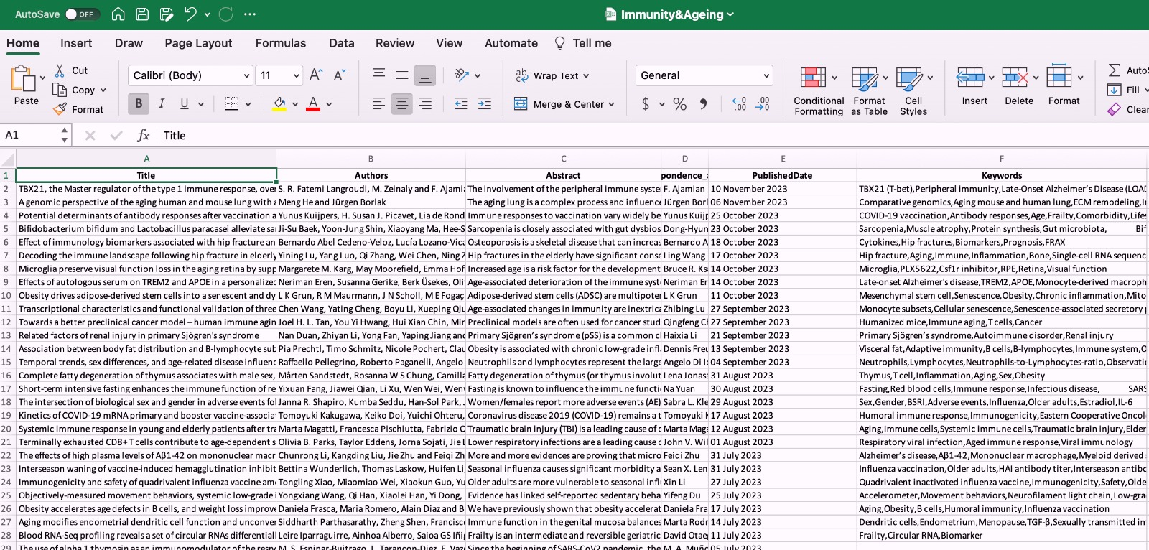
Exporting the Data
Writexl package is used to export the data into an excel, this package is used to read, write and format excel files.

Slide 12
Challenges faced
Web scraping for all the pages of the given website was a bit difficult to get done.
Extracting the keywords HTML code
Performing Data Visualization
Example: counting the number of keywords per article

Slide 13
Thank You
Aravind Kalyan Sivakumar
Mohan Sai Bandarupalli
Vaishnavi Panga

Slide 14
References
https://statsandr.com/blog/web-scraping-in-r/ - rvest
https://www.tutorialspoint.com/data-cleaning-and-preprocessing-with-r
https://www.geeksforgeeks.org/data-visualization-in-r/
https://www.tableau.com/learn/articles/what-is-data-cleaning - :~:text=tools and software-,What is data cleaning%3F,to be duplicated or mislabeled.

